Slide 1
Propulsion Systems for VTOL Electric Vehicles
Jordan Eriksen
29th May 2020
Supervisor:
Dr Sam Grimshaw
Whittle Laboratory

Slide 2
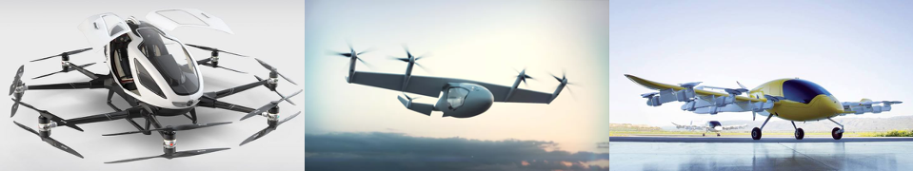
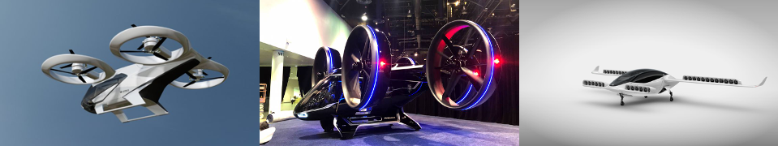
Diversity of e-VTOL
Ducted Fans
Higher thrust
Less Noise
Contained (Safer)
Do they work at a SYSTEM level?
BUT
Notes:
The e-VTOL market is set to treble by 2024.
The eVTOL design space is broad, but the choice of propulsion system is unclear – divided between open propeller and ducted fans (some examples shown in fig)
Ducted fans have a higher theoretical thrust output, are less noisy and are contained, making them safer.
However, they are much heavier [[ due to the casing/intake/exit ducts ]]
So, how do we know which is better at a system level?

Slide 3

Research Question
Does a ducted fan require LESS POWER to maintain hover than a propeller?
$$1^{st}$$
Notes:
The real question is
Does a ducted fan require less power to maintain hover than a propeller?

Slide 4
What factors affect ducted fan performance? How is one designed?
How do ducted fans perform against propellers?
How does ducted fan performance change in a general design space?
Notes:
I will now discuss the work completed during this project to answer that question.
The three main subjects addressed are… (READ SLIDES)

Slide 5
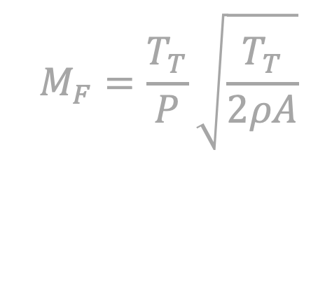
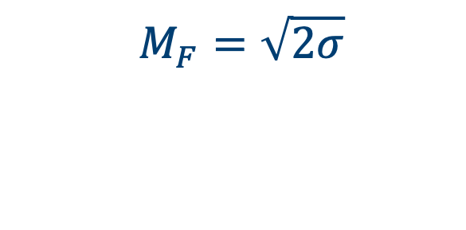



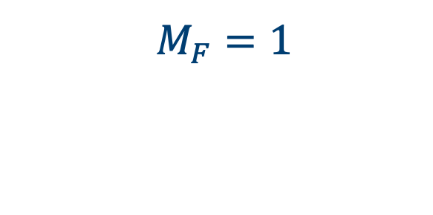
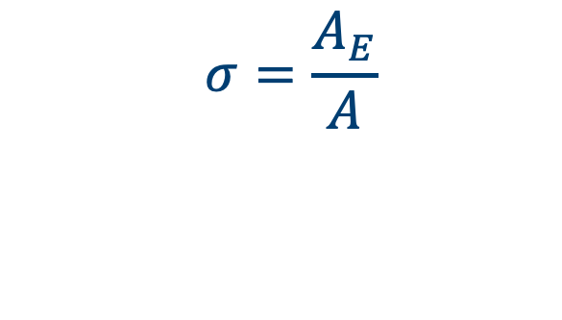
Propulsor Figure of Merit
$$M_{F}=\frac{T_{T}}{P}\sqrt{\frac{T_{T}}{2ρA}}$$
$$A$$
$$A$$
$$A_{E}$$
$$M_{F}=1$$
$$M_{F}=\sqrt{2σ}$$
$$σ=\frac{A_{E}}{A}$$
Pereira (2008)
Notes:
Figure of merit is a non-dim thrust to power ratio that characterizes propulsor performance in hover.
For a propeller the maximum figure of merit is 1, as shown on the left.
For a ducted fan with exit area ratio given by sigma, as shown on the right, the theoretical figure of merit is M_F = sqrt(2\sigma)
Hence this suggests increasing the exit area ratio of the ducted fan will increase performance in hover.

Slide 6



Diffuser Problem
$$M_{F}$$
$$A$$
Weight
$$A_{E}$$
How can we account for weight with a new criteria?
Notes:
FROM BEFORE - “Increasing the exit area improves the figure of merit”
However, exit area ratios greater than 1 turn the exit duct into a diffuser
Diffuser length is limited by flow separation caused by adverse pressure gradients.
Length must scale with area ratio (that is, the amount of diffusion required) to prevent separation
Therefore high figure of merit designs are heavy

Slide 7
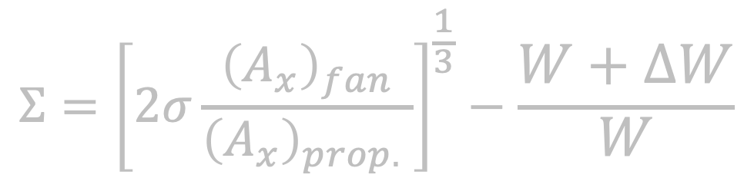
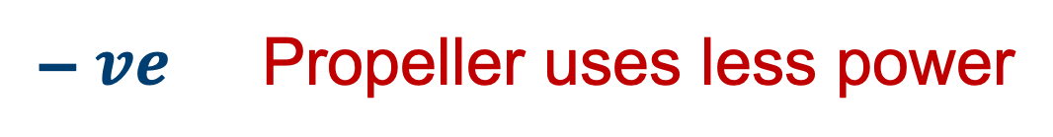


Superiority Condition
$$Σ={\left[2σ\frac{{\left(A_{x}\right)}_{fan}}{{\left(A_{x}\right)}_{prop.} }\right]}^{\frac{1}{3}}−\frac{W+ΔW}{W}$$
$$Σ$$
$+ ve$ Ducted fan uses less power
– $ve$ Propeller uses less power
Notes:
I've derived a superiority parameter to compare a ducted fan design to a propeller
This MUST be positive for the ducted fan to use less power than the propeller to maintain hover
The expression shows that 3 factors affect the value of the superiority parameter. These are (NEXT SLIDE)

Slide 8
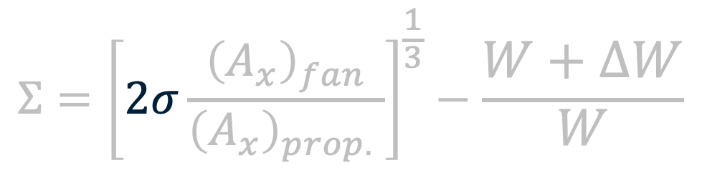
Superiority Condition
$$Σ={\left[2σ\frac{{\left(A_{x}\right)}_{fan}}{{\left(A_{x}\right)}_{prop.} }\right]}^{\frac{1}{3}}−\frac{W+ΔW}{W}$$
$$Σ$$
$+ ve$ Ducted fan uses less power
– $ve$ Propeller uses less power
Notes:
Firstly, the exit duct area ratio, which we've shown to scale with figure of merit such that 2\sigma = M_f^2
We've also shown this to be limited by the diffuser weight
A mass model is required to determine how the choice of area ratio impacts the diffuser weight and the overall weight of the ducted fan

Slide 9
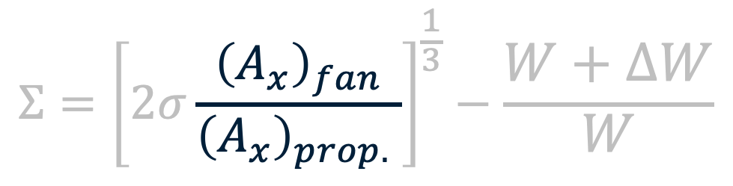
Superiority Condition
$$Σ={\left[2σ\frac{{\left(A_{x}\right)}_{fan}}{{\left(A_{x}\right)}_{prop.} }\right]}^{\frac{1}{3}}−\frac{W+ΔW}{W}$$
$$Σ$$
$+ ve$ Ducted fan uses less power
– $ve$ Propeller uses less power
Notes:
The second term describes the relative size of the ducted fan compared to a propeller (expressed as a flow area ratio)
Fan size is limited by 3 factors
Firstly, the available space wrt overall vehicle design can limit size as a result of needing to fit the propulsor in a wing/fuselage etc
Secondly, the weight limits the propulsor area (again, a mass model is required to determine how)
Finally, manufacturing methods can limit the size
Manufacturing was the main limit in this project as propulsors were 3D printed and so build plate size is the limiting factor

Slide 10
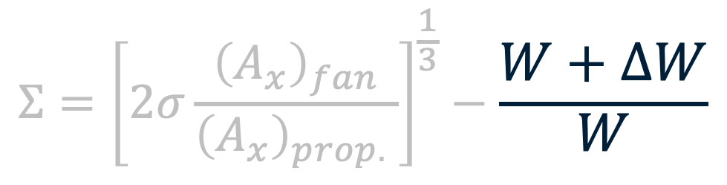
Superiority Condition
$$Σ={\left[2σ\frac{{\left(A_{x}\right)}_{fan}}{{\left(A_{x}\right)}_{prop.} }\right]}^{\frac{1}{3}}−\frac{W+ΔW}{W}$$
$$Σ$$
$+ ve$ Ducted fan uses less power
– $ve$ Propeller uses less power
Notes:
The final term represents the ducted fan weight relative to the weight of the rest of the vehicle. This is expressed in terms of the PAYLOAD, W, and the ducted fan weight, delta W
PAYLOAD is used to describe the total vehicle weight minus the weight of the propulsor.
So a mass model is again required to relate operating point (that is the thrust generated) to ducted fan weight
How do we design a fan given these competing factors?
First need a design context (need to know the payload, W, and how the fan weight, \Delta W, varies with design point)

Slide 11
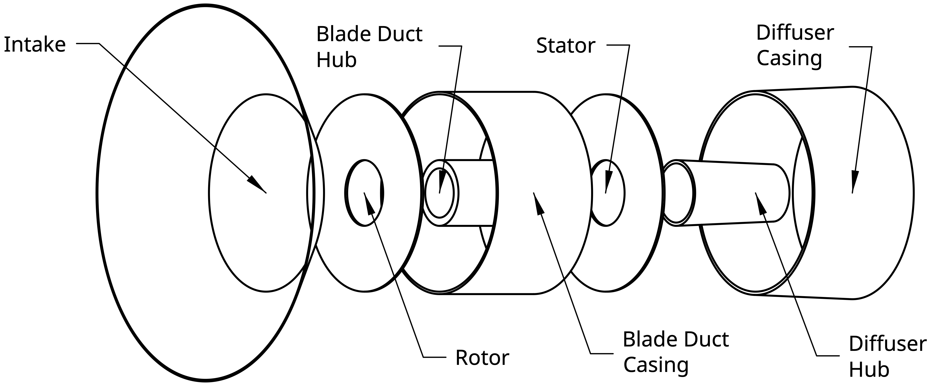

Superiority Condition
$$Σ={\left[2σ\frac{{\left(A_{x}\right)}_{fan}}{{\left(A_{x}\right)}_{prop.} }\right]}^{\frac{1}{3}}−\frac{W+ΔW}{W}$$
Ducted Fan Mass Model
$$ΔW=f(σ,A_{x})$$
Notes:
I've developed a simple mass model to predict propulsor weight given the exit area ratio, sigma, and the fan flow area A_x

Slide 12
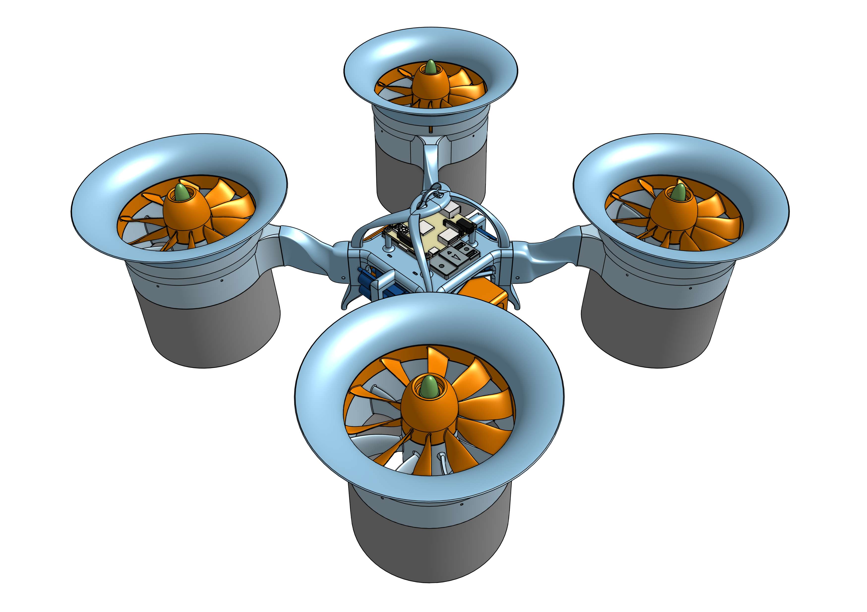
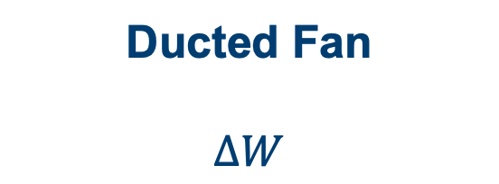
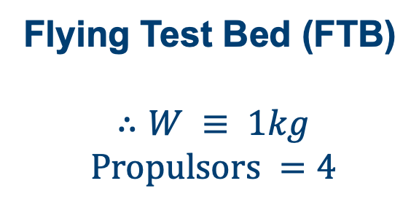
Design Context
Ducted Fan
$$ΔW$$
Flying Test Bed (FTB)
$$∴W ≡ 1kg$$
$$Propulsors =4$$
Notes:
The design payload is for a custom-made flying test bed with a mass of 1kg.
This controls data collection,
Powers the motors and the onboard computers,
And has an onboard flight controller managing vehicle dynamics in flight
(Render only due to lab being shut)
So how is a ducted fan designed?

Slide 13
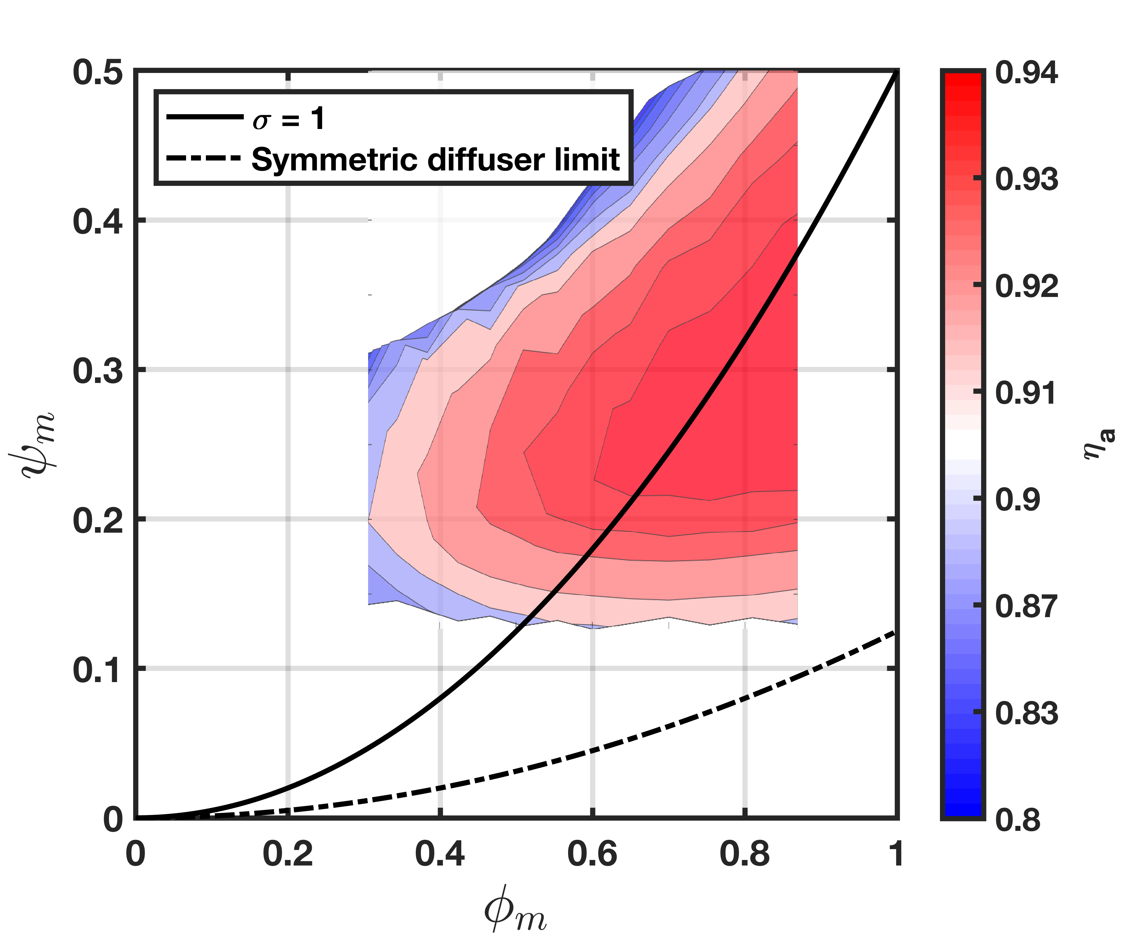
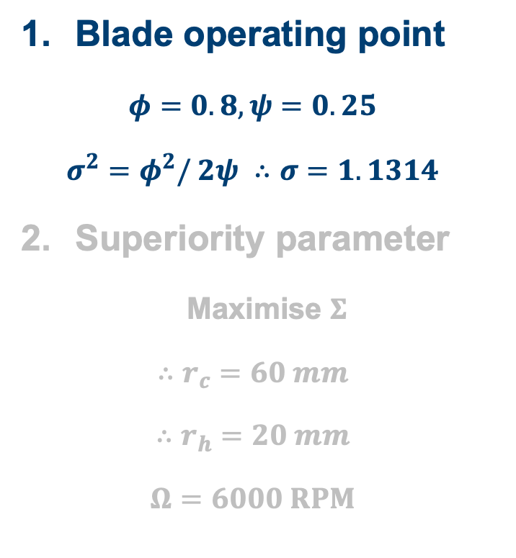
Design Process
Blade operating point
$$φ=0.8, ψ=0.25$$
$$σ^{2}=φ^{2}/ 2ψ ∴σ=1.1314$$
Superiority parameter
Maximise $Σ$
$$∴r_{c}=60 mm$$
$$∴r_{h}=20 mm$$
$$Ω=6000 RPM$$
Operating point
Notes:
Design process is broken down to simplify the problem
FIRST, the mean-line turbomachinery operating point is considered in terms of flow coefficient and stage loading
Due to the size of the fan, the Reynold numbers are around 50,000.
Therefore Maffioli LOW RE profiles are used in the design
Using a Smith chart from Maffioli’s original paper, and limiting the design space by exit duct area ratio, operating point chosen (as shown in fig)
These limits result from designing for an area ratio greater than 1 (solid line)
And a symmetric diffuser limit resulting from the hub exit cone on a symmetric diffuser converging to a point
By designing between these limits, and in a high efficiency region of the smith chart, the operating point is...
IF ASKED ABOUT HIGH FLOW COEFFICIENT – AS IN HOVER

Slide 14
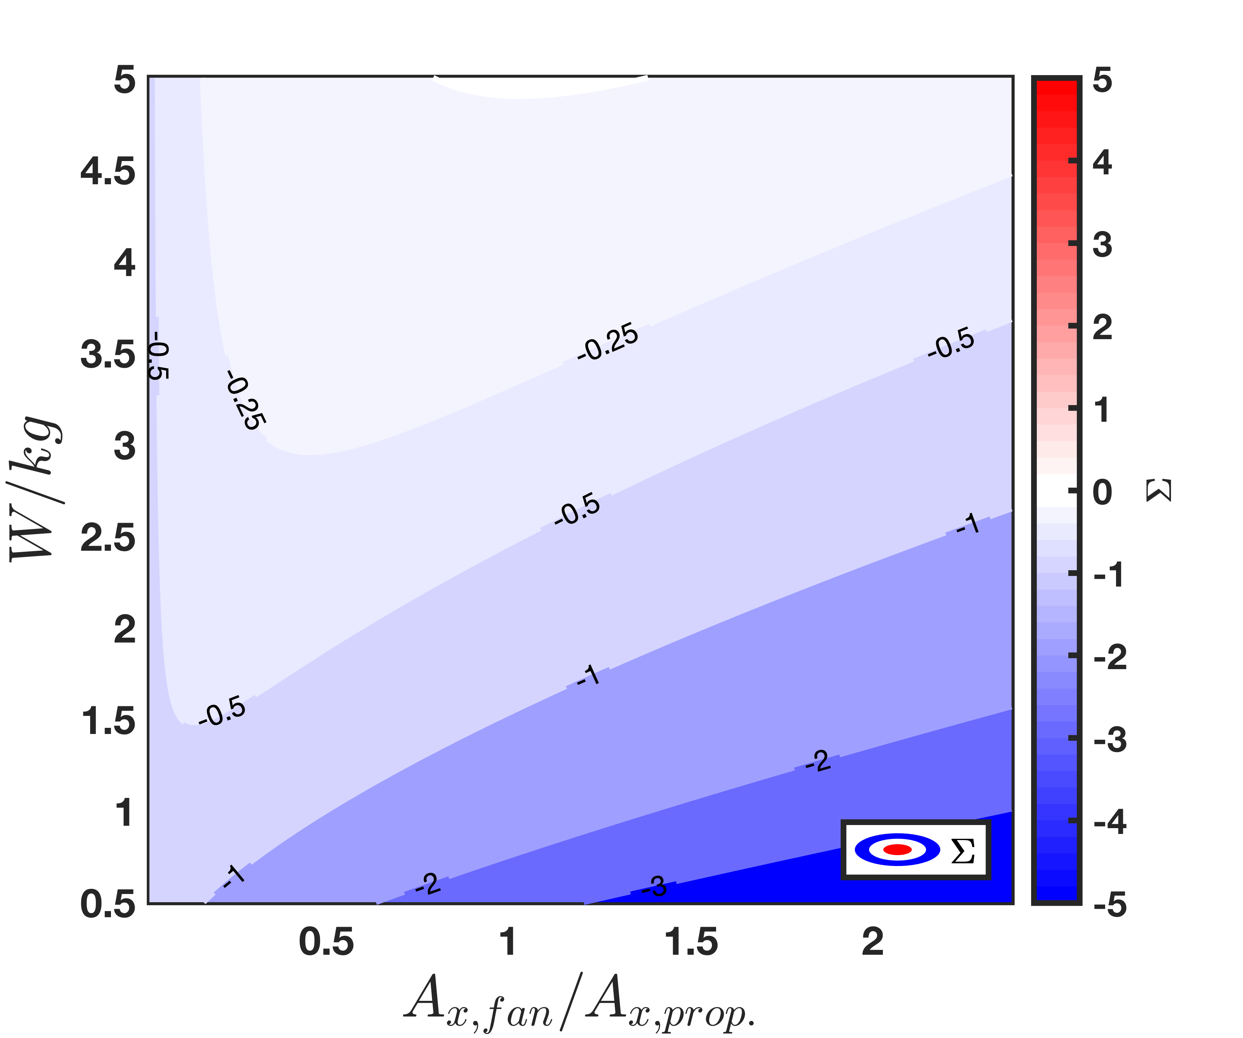
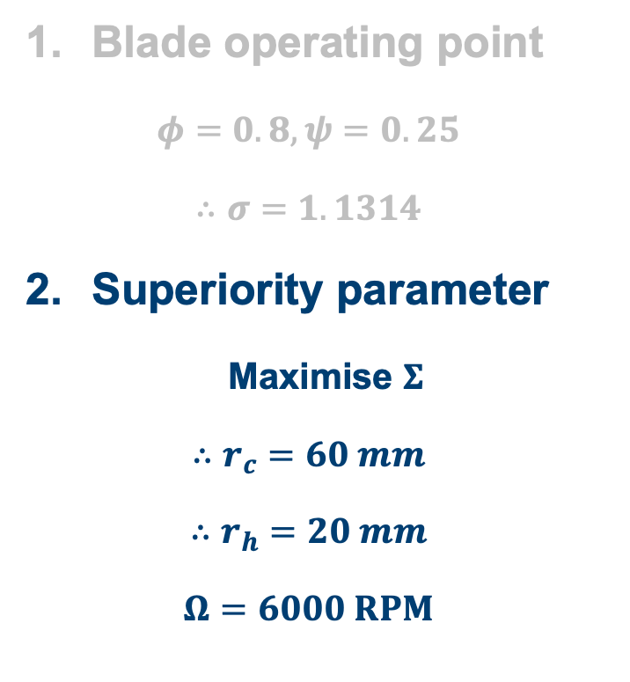
Design Process
Blade operating point
$$φ=0.8, ψ=0.25$$
$$∴σ=1.1314$$
Superiority parameter
Maximise $Σ$
$$∴r_{c}=60 mm$$
$$∴r_{h}=20 mm$$
$$Ω=6000 RPM$$
Notes:
The superiority parameter is also to be maximised
The graph shows the sup. para. in terms of payload, W, and relative fan size on the x-axis.
Payload is fixed at 1kg (weight of the FTB)
Payload shown by green line
The figure shows the superiority parameter is negative throughout the design space and so superiority condition is NOT satisfied for a payload of 1kg.
This is because the payload is too small wrt the propulsor
Therefore fan size is limited only by manufacturing methods
A design with rc = 60mm and rh = 20mm is chosen, giving a fan speed of 6000 RPM

Slide 15
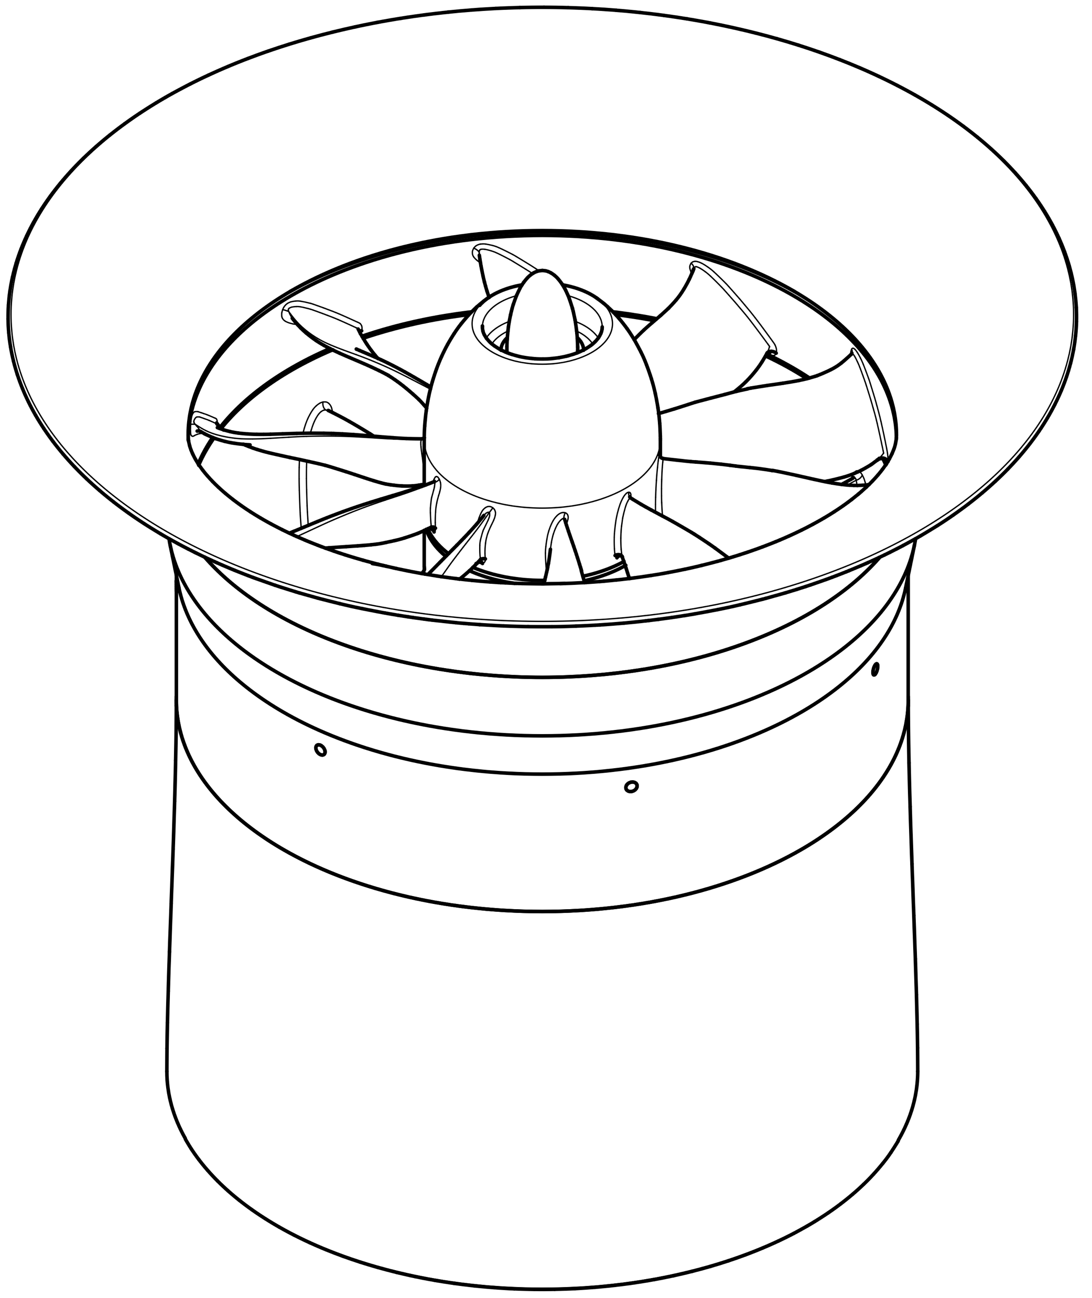
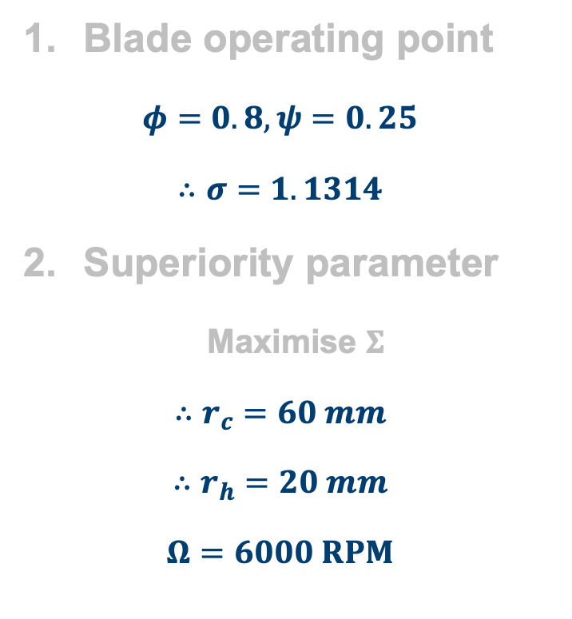

Design Process
Blade operating point
$$φ=0.8, ψ=0.25$$
$$∴σ=1.1314$$
Superiority parameter
Maximise $Σ$
$$∴r_{c}=60 mm$$
$$∴r_{h}=20 mm$$
$$Ω=6000 RPM$$
$$L=167 mm$$
Notes:
The gives an embodied design that looks like this
Rotor has 11 blades, Stator has 7 blades
Length 167mm

Slide 16
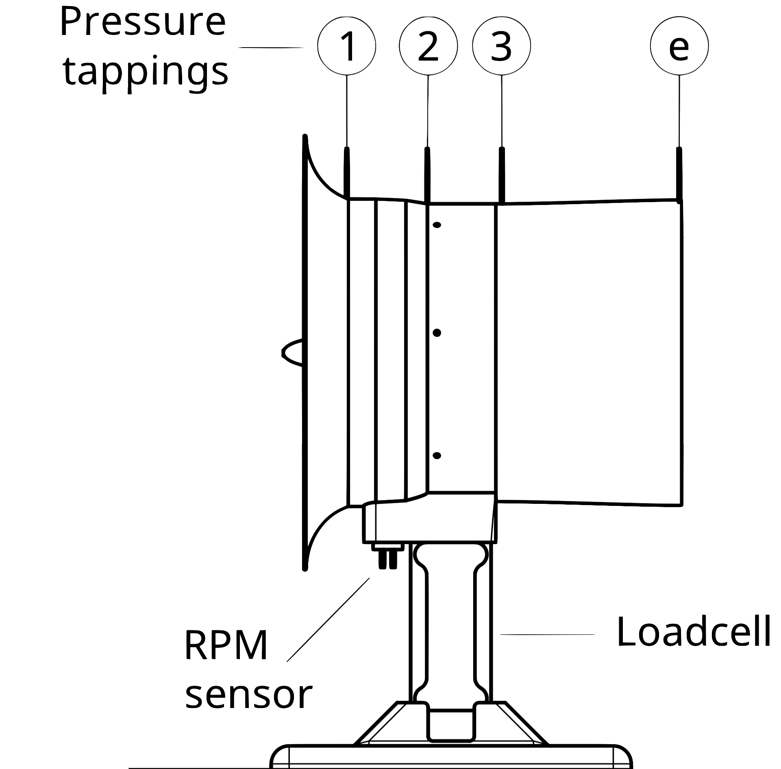
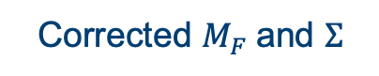
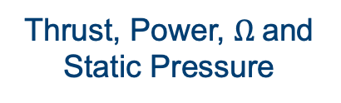
Stationary Test Rig
Measured:
Thrust, Power, $Ω$and Static Pressure
Evaluated:
Corrected $M_{F}$and $Σ$
Notes:
The stationary test rig is used to evaluate the figure of merit (corrected for the electrical efficiency), and the superiority parameter for each propulsor
This is achieved by measuring the thrust, power and rpm of the propulsors
AS well as the static pressure at various locations across the propulsor length

Slide 17
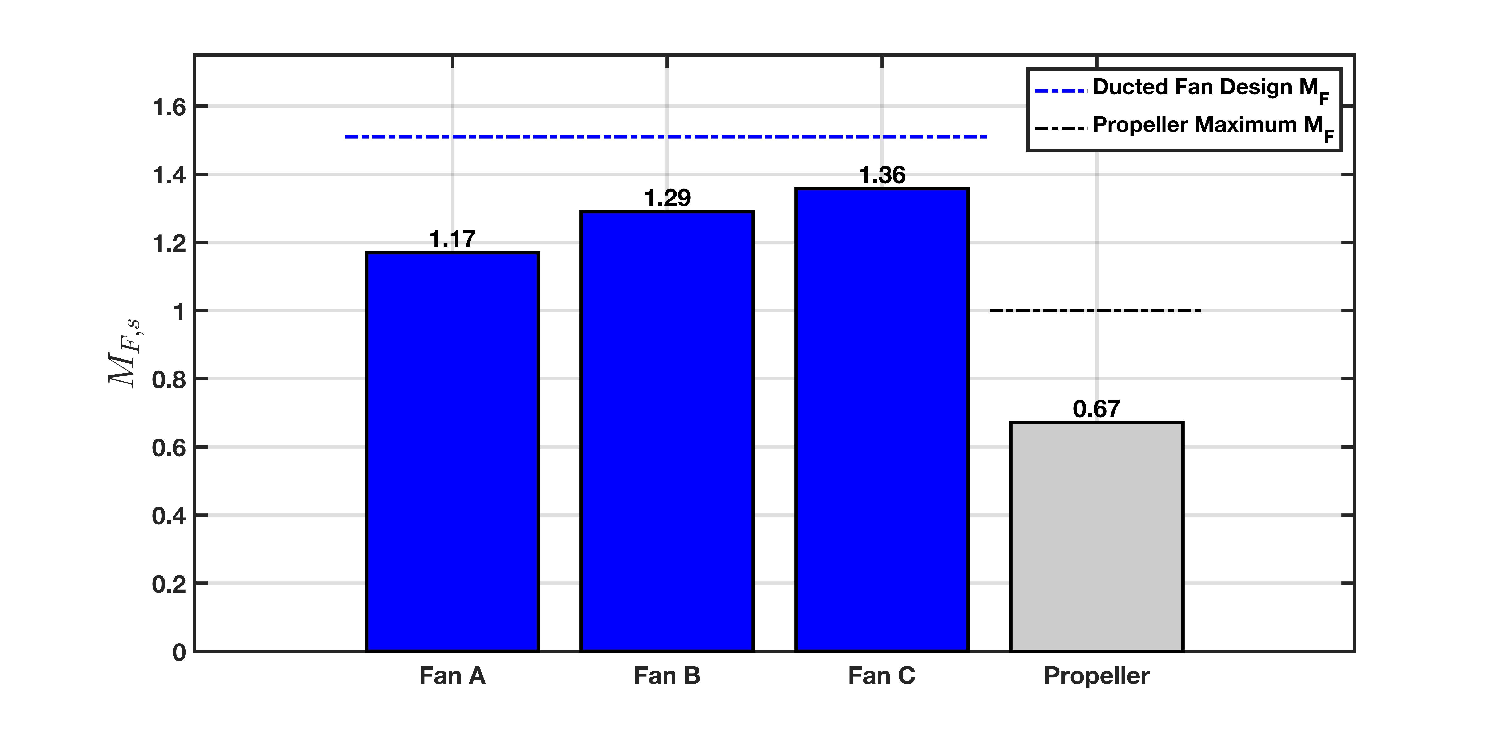
Results – Figure of Merit
Notes:
This figure shows that 3 fans and 1 VTOL optimized propeller were tested on stationary test rig.
The maximum fan FoM was 1.36, which is 103% higher than prop, at 90% of it’s design value
This shows that figure of merits greater than the propeller maximum value can be achieved
Though this is done on stationary rig, it should be noted that hover tests with the propeller supported these results.
Now I’ll discuss the hypothesized sources of loss for each fan

Slide 18
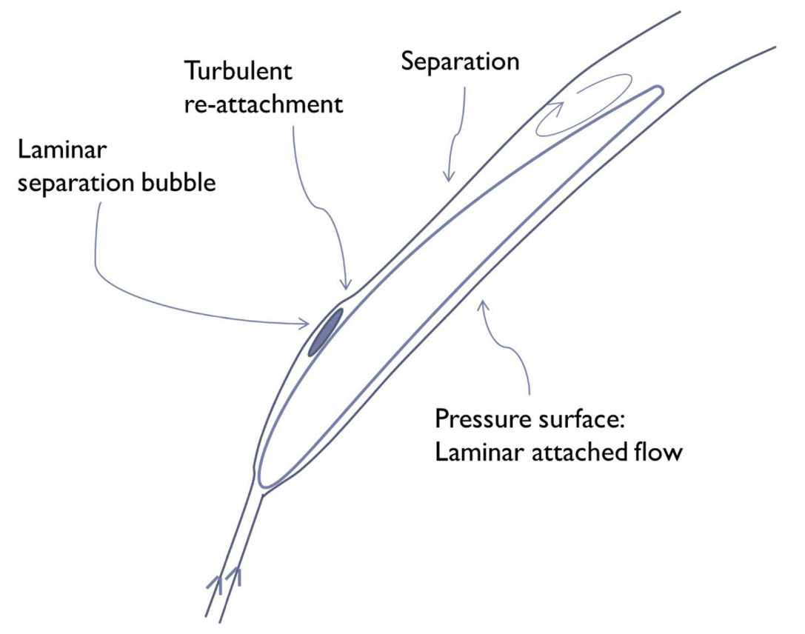
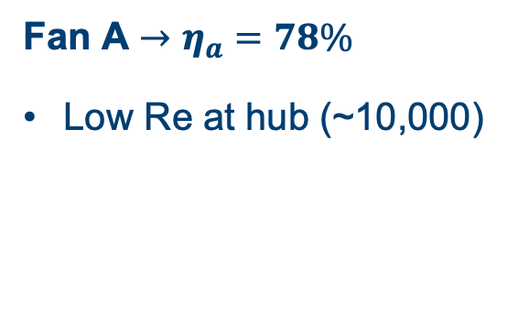
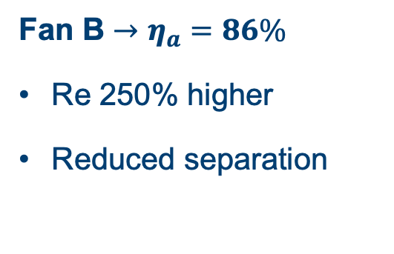
Fan A vs Fan B – Low Reynolds Separation
Fan A $→η_{a}=78\%$
Low Re at hub (~10,000)
Fan B $→η_{a}=86\%$
Re 250% higher
Reduced separation
Maffioli et al. (2015)
Notes:
Fan A has a constant angle vortex distribution – which results in the hub chord being very small
As a result the Re is very low, approx. 10,000. This results in considerable low Re separation, a description of which is shown in the figure
Fan B has a free vortex distribution
Hub chord is 200% that of Fan A
and has Re 250% larger
Less separation therefore occurs, driving the aerodynamic efficiency up.

Slide 19
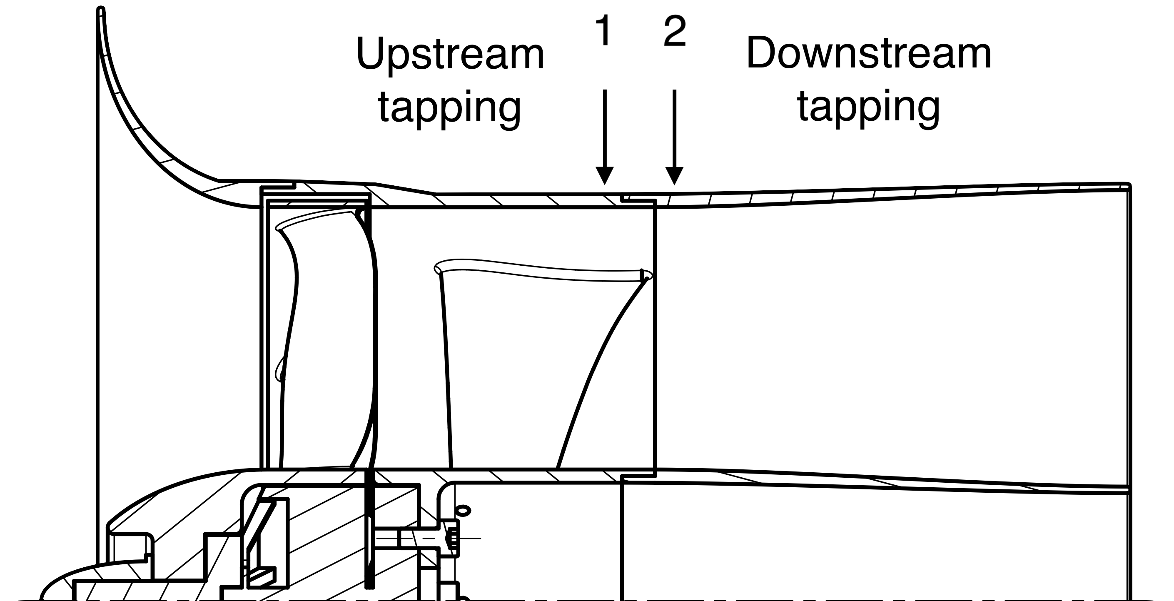
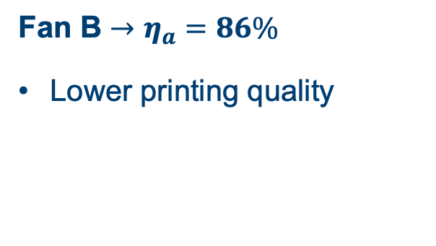
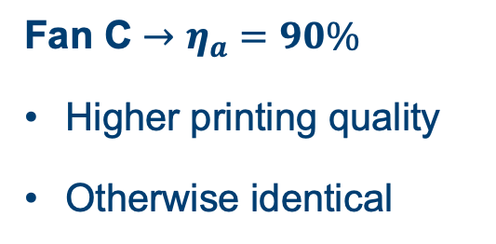
Fan B vs Fan C – Diffuser Performance
Fan B $→η_{a}=86\%$
Lower printing quality
Fan C $→η_{a}=90\%$
Higher printing quality
Otherwise identical
Notes:
The difference in performance between fans B and C can only be accounted for by diffuser performance, as all other aspects of the design are the same
Two static pressure tappings were made, one just upstream and one just downstream of the joining line between the casing and the diffuser. The static pressure should be equal at both, however it was found to be notably different, suggesting flow separation had occurred.
This is a result of poor 3D printing quality. The joining line was found to have a large step. 3D printing issues were resolved for Fan C, and so no noticeable step was observed between the casing and diffuser, meaning the efficiency of fan C increased.

Slide 20



Fan A, B and C – Shroud Clearance Flows
$$Δη_{a}=f\left(g,h,flow angles\right)=5\%→ 11\%$$
Yoon (2015)
$$g$$
Shroud
$$h$$
ROTOR
Notes:
All 3 fans are believed to be affected by shroud clearance flows. Using Yoon’s loss model, the loss in efficiency is calculated to be between 5 and 11%, depending on the choice of discharge coefficient.
Manufacturing tolerances required a tip gap equivalent to 5% of span.

Slide 21
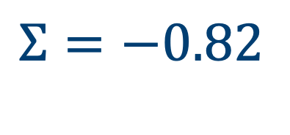
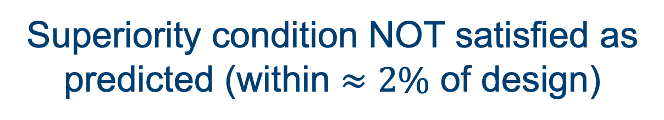
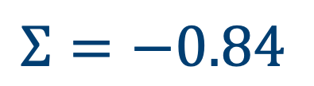
Results – Superiority Parameter
Experiment
$$Σ=−0.82$$
Design
$$Σ=−0.84$$
Superiority condition NOT satisfied as
predicted (within $≈2\%$ of design)
Notes:
From experiment, the superiority parameter is found to be within 2% of the predicted design value.
But the superiority condition is not satisfied.
How can we design for positive superiority parameter?

Slide 22
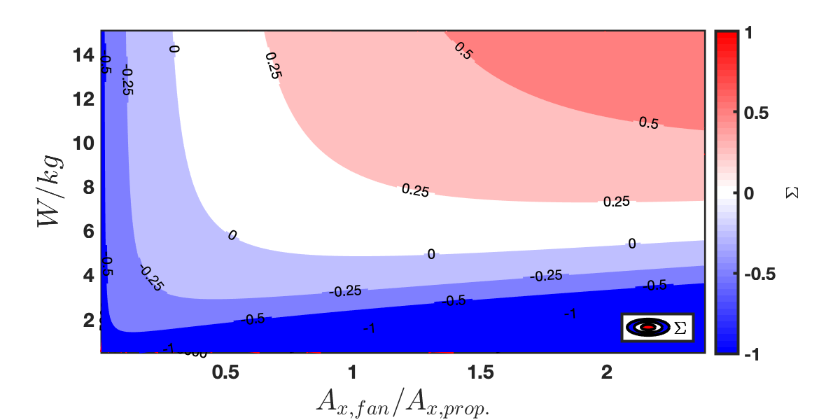
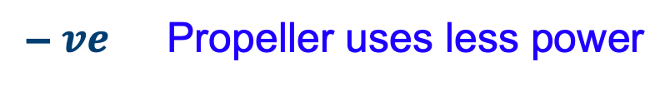


Superiority Parameter: Effect of Payload and Relative Size
$$Σ$$
$+ ve$ Ducted fan uses less power
– $ve$ Propeller uses less power
Notes:
This figure shows design space for payloads up to 15 kg, and in the same range of area ratios considered earlier
This shows the superiority parameter CAN be satisfied, provided sufficient area ratio and payload
The minimum payload for a ducted fan to satisfy the superiority parameter is approx 5kg for this design, as shown.
This is evaluated by finding minima of zero contour.
Similarly, the optimum relative fan size can be found for any payload, as every contour is shown to have a minima.
How can this region of positive superiority parameter be maximized? I found the most promising method of achieving this is by using contra-rotating ducted fans.

Slide 23
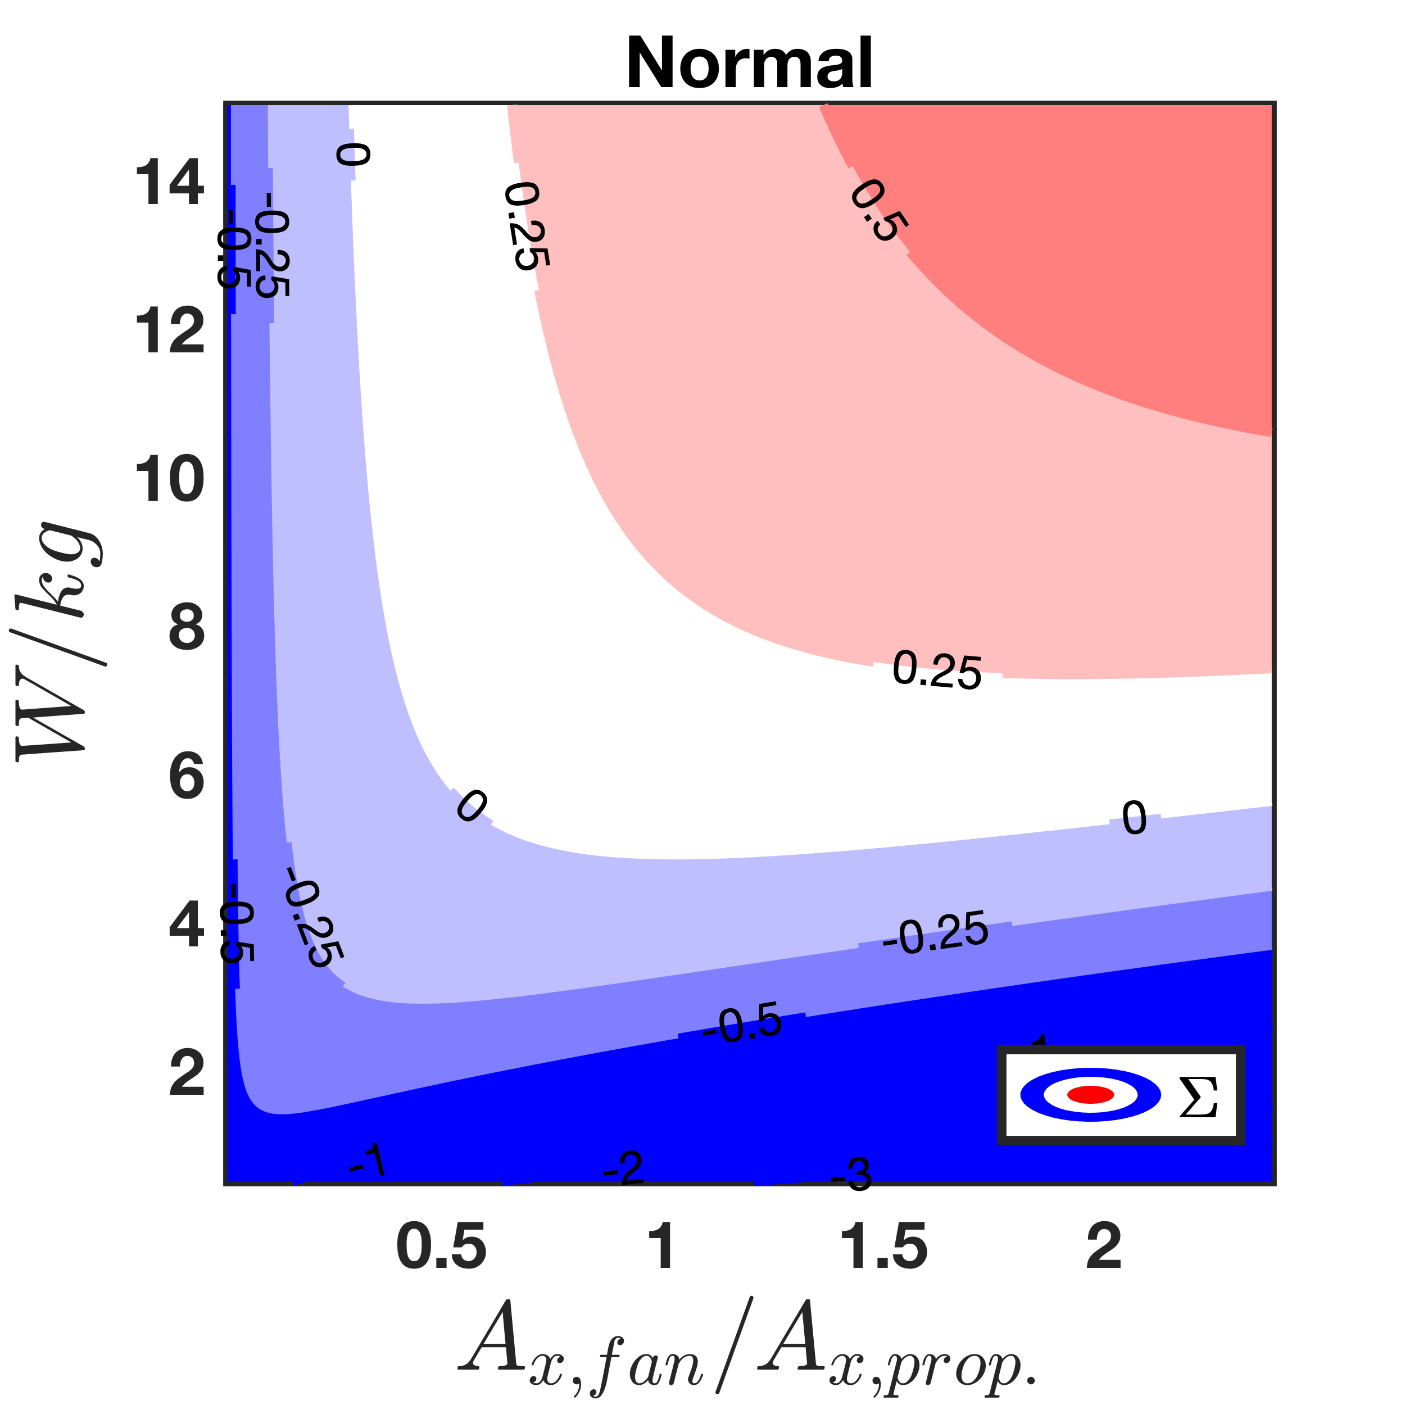
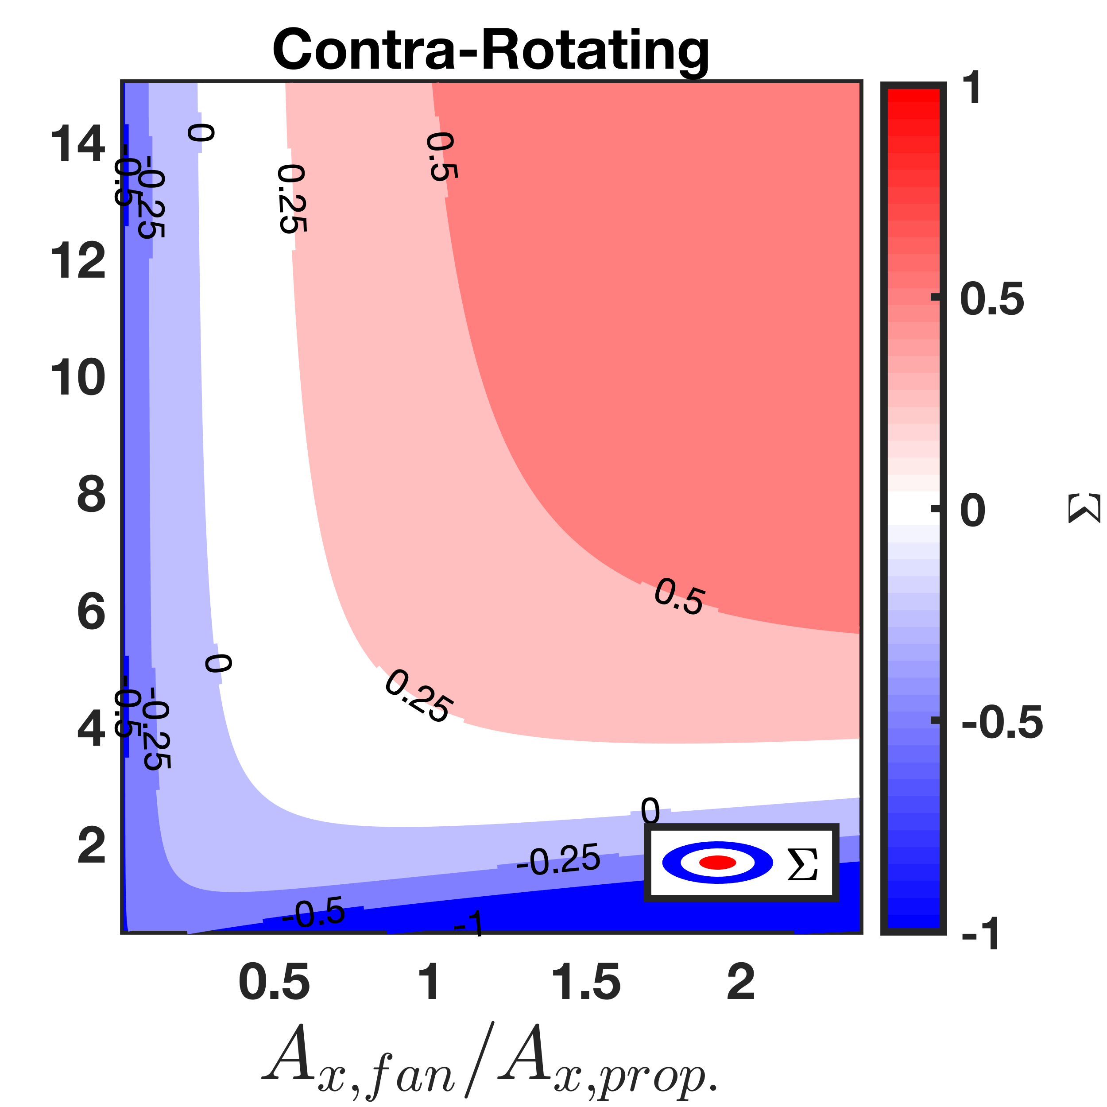


Superiority Parameter: Contra-rotating Ducted Fans
$$W_{min}≈5kg$$
$$W_{min}≈2.3kg$$
Notes:
This figure shows the same design space for normal df on the left, and CRDF on the right. The region of positive superiority parameter has grown considerably.
The minimum payload for superiority parameter to be positive is now approximately 2.3kg, as opposed to 5kg
This shows a much larger design space for power reduction.
CRDFs can double the thrust output when the blades are operating at the same non-dimensional operating point and efficiency [[as in Waldren]]).
Hence the number of propulsors required can be halved. Another way of improving the superiority parameter is by using Lighter manufacturing methods (CFRP for big designs)
I’ve shown that by using my superiority parameter design charts, the design problem becomes easy, as the choice of propeller or ducted fan is binary

Slide 24
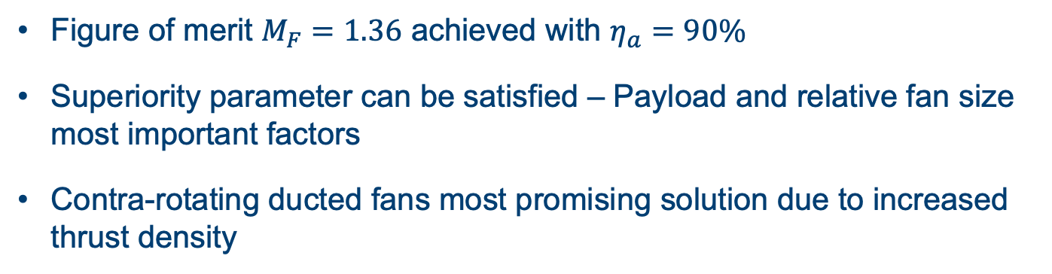
Conclusions
Ducted fans CAN consume less power in hover than propellers, provided the superiority parameter is satisfied.
Figure of merit $M_{F}=1.36$ achieved with $η_{a}=90\%$
Superiority parameter can be satisfied – Payload and relative fan size most important factors
Contra-rotating ducted fans most promising solution due to increased thrust density
Future Work:
CRDFs must be tested & achieve a positive superiority parameter
Notes:
In conclusion
I have shown that ducted fans CAN consume less power than propellers in hover, provided the superiority condition is satisfied
I’ve designed a ducted fan that can achieve a figure of merit of 103% larger than a propeller, with an aerodynamic efficiency of 90%
I’ve shown the superiority condition can be satisfied, provided sufficient payload and fan size
Finally, I’ve presented CRDFs as the most promising technology for improving propulsion system performance in a VTOL application.
Suggested future work includes designing and testing a CRDF designed to achieve a positive superiority parameter

Slide 25
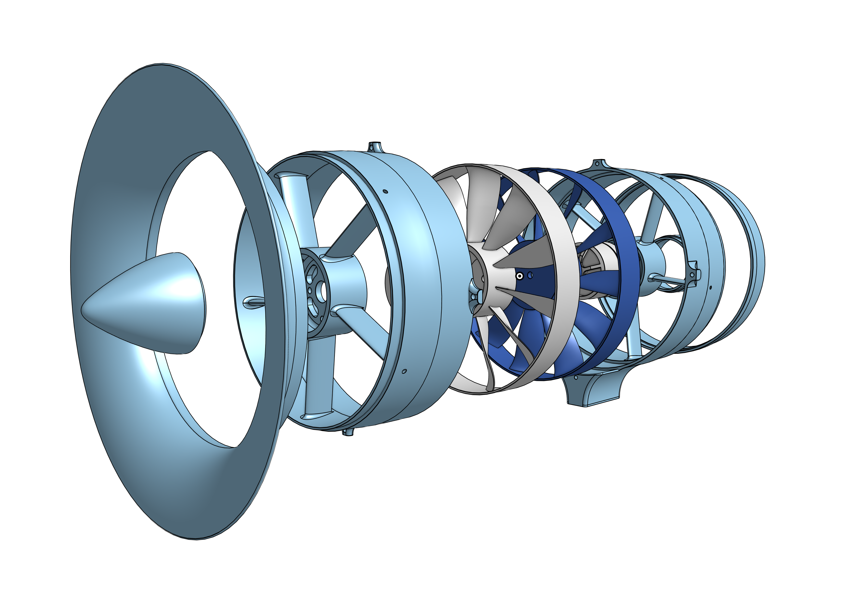
CRDF Design Candidate
CRDF Design
Notes:
Waldren’s paper shows that operating point in the relative frame determines blade efficiency.
Consider two rotors spinning at the same speed in opposite directions.
In frame of reference of the 2nd rotor, the machine looks like a normal DF.
Rotor 1 is spinning much faster in the relative frame, so to achieve the same flow coefficient as the NDF, the axial flow velocity must increase.
Moving back to the absolute frame, each rotor spins at the original speed, but the axial velocity is now larger, without changing the blade’s operating point.
Thrust scales with $V_{x}^{2}$ and I show in my report that with constant stage loading, the increase in $V_{x}$ in the absolute frame is sqrt(2)
Therefore thrust doubles.

Slide 26
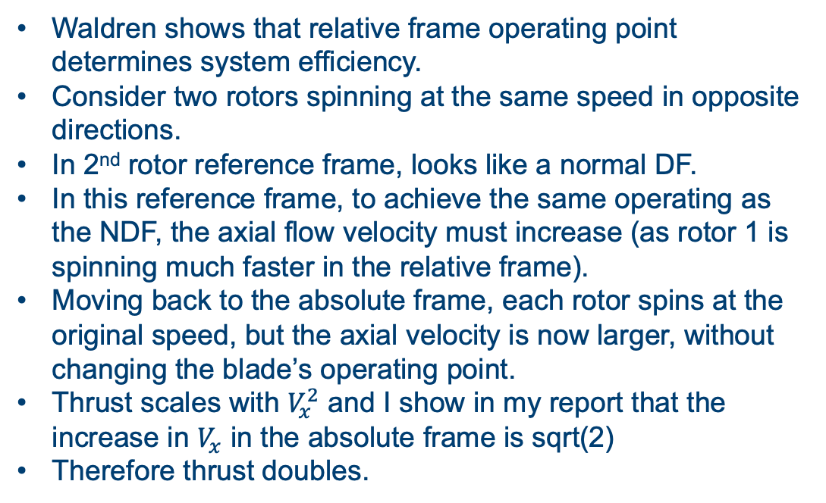
CRDF Design
Waldren shows that relative frame operating point determines system efficiency.
Consider two rotors spinning at the same speed in opposite directions.
In 2nd rotor reference frame, looks like a normal DF.
In this reference frame, to achieve the same operating as the NDF, the axial flow velocity must increase (as rotor 1 is spinning much faster in the relative frame).
Moving back to the absolute frame, each rotor spins at the original speed, but the axial velocity is now larger, without changing the blade’s operating point.
Thrust scales with $V_{x}^{2}$ and I show in my report that the increase in $V_{x}$ in the absolute frame is sqrt(2)
Therefore thrust doubles.

Slide 27
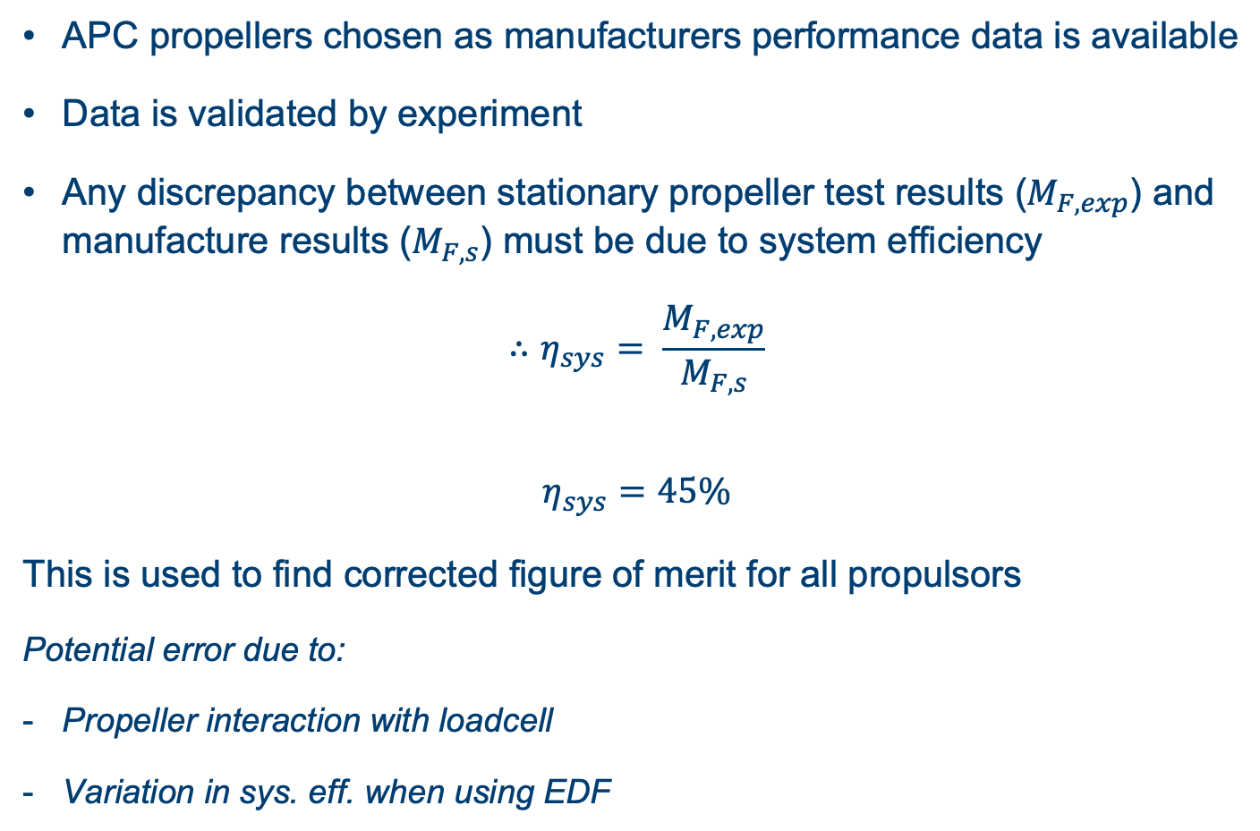
Calculating System Efficiency
APC propellers chosen as manufacturers performance data is available
Data is validated by experiment
Any discrepancy between stationary propeller test results ($M_{F,exp}$) and manufacture results ($M_{F,s}$) must be due to system efficiency
$$∴η_{sys}= \frac{M_{F,exp}}{M_{F,s}}$$
$$η_{sys}=45\%$$
This is used to find corrected figure of merit for all propulsors
Potential error due to:
Propeller interaction with loadcell
Variation in sys. eff. when using EDF

Slide 28
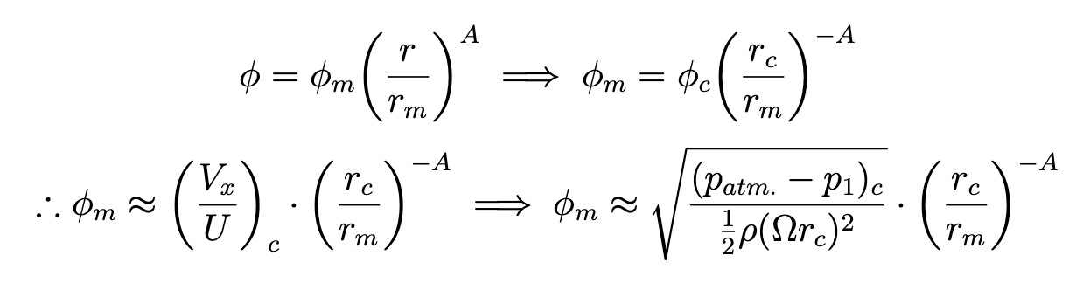
Determining Mean-Line from Casing
Assume distribution is as designed
Evaluate the flow coefficient at casing
Extrapolate distribution

